Slide 1

N.B.K.R.INSTITUTE OF SCIENCE AND TECHNOLOY (Autonomous) DEPARTMENT OF SCIENCE AND ENGINEERING
College department management

Slide 2
College department management
TEAM MEMBERS
V. THANUSHA - 24KB1AO5MQ
V. GAYATHRI - 24KB1A05MB
U.LAVANYA- 24KB1AO5LS

Slide 3
INTRODUCTION
This project demonstrates a simple department management system in c.
Each department is stored in an array.
Each department maintains a linked list of faculty members.

Slide 4
Data structures used
ARRAY : To store list of departments.
LINKED LIST : To store faculty members in each department
Each node contains :
Faculty Name
Pointer to next node

Slide 5
CODE OVERVIEW
Functions implemented:
CreateFaculty() : create a new faculty node .
addFaculty() : Add faculty to department .
displayDepartment() : print departments and faculty info.
Main function initializes departments and adds sample data.

Slide 6
Advantages of This system
Easy to extend with new department or faculties
Simple linked list management for dynamic data
Efficient for small to medium-size college data

Slide 7
Limitations and future scope
No file storage in current version
No real time user input handling
Can be extended with:
*File I/O for persistent storage
*User input for dynamic data entry
*GUI or Web-based frontend

Slide 8
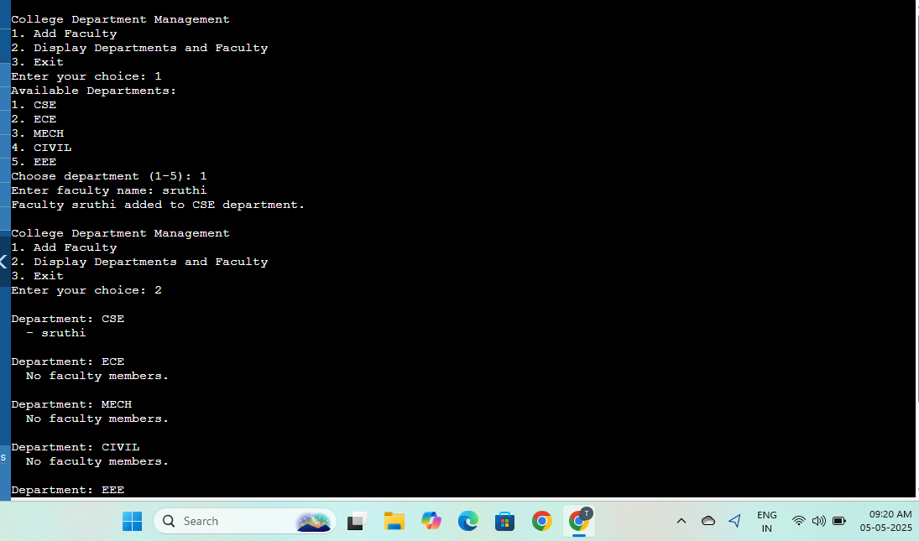
Sample output:

Slide 9
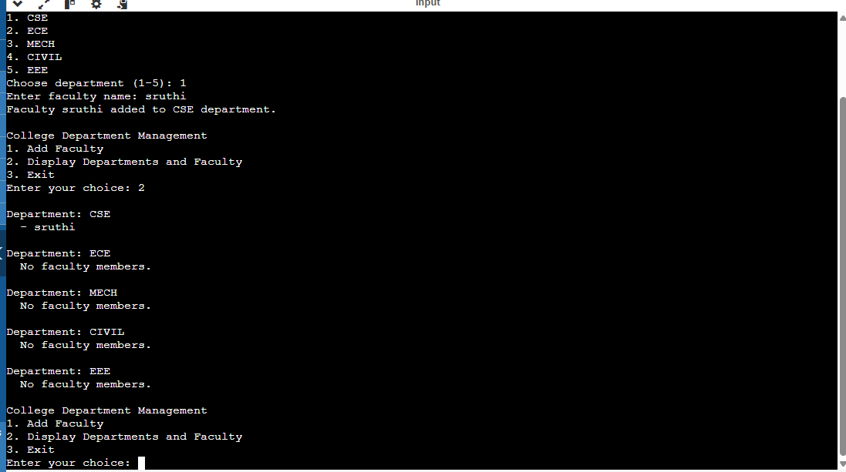

Slide 10
Conclusion
This project demonstrates efficient department management using basic c structures.
Expandable by integrating file I/O or user inputs for practical usage.
Good practice for combining arrays and linked lists in real-world application.

